Slide 1
Ggplot2 and interactive graphics with R
Christophe Ladroue
SECTION 06
VIDEO 03
Rendering textual information
www.PacktPub.com

Slide 2
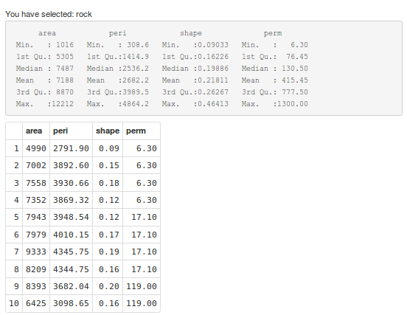
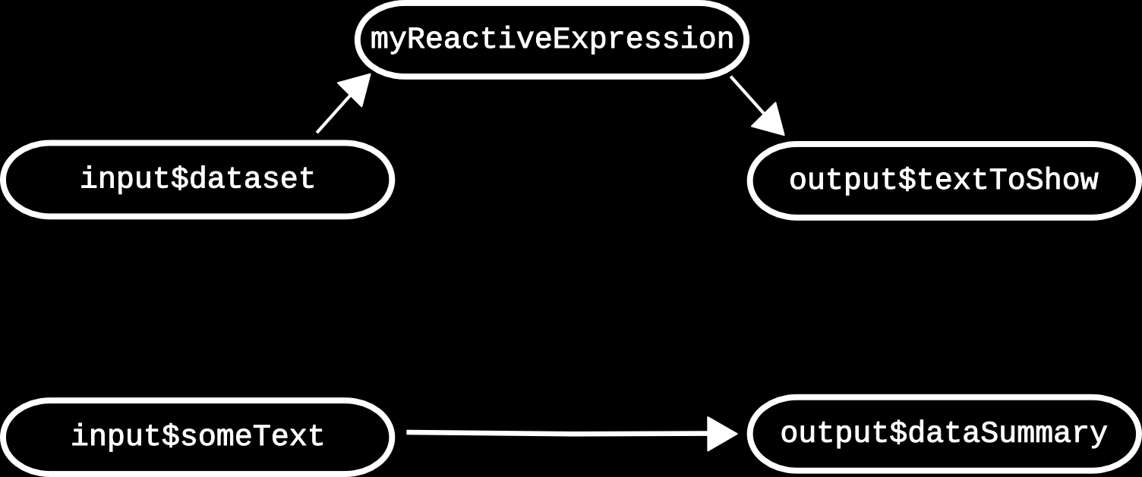
In this video we took a look at
three different ways of rendering text.
RenderText ↔ textOutput
RenderPrint ↔ verbatimTextOutput
RenderTable ↔ tableOutput
Next: reactive programming

Slide 3
In this section we’re going to take a look at
creating interactive webpages with Shiny.
understanding the structure of a shiny app.
rendering text
understanding reactive programming
using a button to avoid frequent updates

